Slide 1
Project Review Meeting-I
Gym Membership Management System
DBMS Cornerstone Project – Project 18
Presented by
1)R. Jayanth 25B11CS805
2)K. M. Shivaranjith Kumar 25B11CS361
3)C. Ranjith Kumar 25B11CS143
4)R. P. Uday Kumar 25B11CS814
Date of Presentation: 13-08-2026

Slide 2


PROBLEM STATEMENT
Current Challenges
Proposed Solution
Manual gym record management is time-consuming and error-prone
Implement a relational database system to centrally manage all gym operations in a structured, organized manner.
Difficulty maintaining accurate member information across departments
Member Details
Trainer Info
Centralized profiles
Specializations tracked
Payment tracking is disorganized and inconsistent
Memberships
Payments
Attendance records are scattered and hard to retrieve on demand
Plans and validity
Accurate records
Duplicate and inconsistent data across multiple record sets
Difficulty searching and retrieving specific member information quickly
Attendance
Structured logs

Slide 3

WHY THIS PROJECT IS NEEDED
Manual gym record management introduces significant operational risk. A centralized relational database eliminates these inefficiencies by organizing all gym operations — members, payments, attendance, trainers, and workouts — into a single, structured, and accurate system.
The Problem: Manual Record Keeping
The Solution: Centralized Relational Database
Time-Consuming & Error-Prone
Faster Access
Manual processes introduce human error and consume staff time that could be allocated to member-facing services.
Instantly retrieve member, membership, payment, attendance, trainer, and workout information without manual searching.
Disorganized Payment Tracking
Without a structured system, payment records become inconsistent and difficult to reconcile across periods.
Data Consistency
Relational structure maintains integrity across all linked records, eliminating contradictions between tables.
Scattered Attendance Records
Attendance logs maintained separately are slow to retrieve and prone to gaps or duplication.
Reduced Redundancy
Duplicate & Inconsistent Data
A single source of truth for each entity prevents duplicate entries and simplifies record maintenance.
Maintaining separate registers for members, memberships, and payments leads to conflicting records and data integrity failures.
Therefore, the Gym Membership Management System replaces scattered and manual record keeping with a centralized, structured, accurate, and efficient database system.

Slide 4
OBJECTIVES
System Objectives
Functional Requirements
1
Manage member and trainer details efficiently
Manage Members
Manage Trainers
Maintain complete profiles including contact, specialization, and join history.
2
Record payments, attendance, and workouts
Manage Memberships
Record Payments
Accurate, timestamped logs for all financial transactions and daily check-ins.
Record Attendance
Manage Workouts
3
Reduce redundancy and maintain integrity
Normalize data to eliminate duplication and enforce consistency at every level.
Non-Functional Requirements
4
Provide faster and accurate data retrieval
Security
Accuracy
Enable instant search, filtering, and reporting across all six modules.
Reliability
Performance
Usability
Data Integrity
Functional requirements describe WHAT the system does; Non-functional requirements describe HOW it performs.

Slide 5
END USERS ,MODULES AND ENTITIES
End Users & Responsibilities
Core Entities
User
Responsibilities
Entity
Gym Administrator
Manage members, trainers, memberships, payments, attendance
Member
Trainer
Trainer
Manage workout information and monitor assigned members
Membership
System Modules
Payment
Attendance
Member Management
Workout
Trainer Management
Membership Management
Payment Management
Attendance Management
Workout Management

Slide 6
ENTITY ATTRIBUTES
Entity
Attributes
Member
MemberID (PK), FirstName, LastName, Gender, Phone, JoinDate, Age
Trainer
TrainerID (PK), TrainerName, Specialization, Phone
Membership
MembershipID (PK), MemberID (FK), Plan, StartDate, EndDate
Payment
PaymentID (PK), MemberID (FK), Amount, PaymentDate
Attendance
AttendanceID (PK), MemberID (FK), AttendanceDate, CheckIn
Workout
WorkoutID (PK), TrainerID (FK), WorkoutType, Duration
Attribute Types
Composite Attribute
Multi-valued Attribute
Derived Attribute
Name → FirstName + LastName. A composite attribute is one that can be subdivided into smaller sub-parts, each representing a more basic attribute with its own independent meaning.
Phone — A multi-valued attribute can hold more than one value for a single entity instance (e.g., multiple phone numbers per member).
Age — Calculated from JoinDate or Date of Birth. A derived attribute's value is not stored directly but computed from other stored attributes.

Slide 7
ENTITY JUSTIFICATION
The database is structured around 6 core entities, each representing a distinct real-world object or operational activity within the gym. Together, they eliminate redundancy and ensure all relevant data is captured, organized, and retrievable.
Entity
Real-World Object
MEMBER
Gym Member
Stores the personal and basic information of gym members — the central entity around which all other entities are linked.
TRAINER
Fitness Trainer
Stores trainer details and specialization information, enabling assignment of workouts and accountability for training activities.
MEMBERSHIP
Membership Plan
Stores the membership plan type and validity details associated with each member, supporting subscription lifecycle management.
PAYMENT
Payment Transaction
Records all payment transactions made by members, providing a structured financial audit trail within the system.
ATTENDANCE
Daily Check-In
Maintains the daily attendance and check-in history of members, enabling usage pattern analysis and access control.
WORKOUT
Workout Session
Stores workout information associated with trainers, allowing structured scheduling and assignment of training sessions.

Slide 8
KEYS AND CONSTRAINTS
Keys and constraints maintain data accuracy, consistency, and referential integrity.
PRIMARY KEYS
FOREIGN KEYS
Membership.MemberID → Member.MemberID
Payment.MemberID → Member.MemberID
MemberID
TrainerID
Member
Trainer
Attendance.MemberID → Member.MemberID
Workout.TrainerID → Trainer.TrainerID
MembershipID
PaymentID
CONSTRAINTS
Membership
Payment
PRIMARY KEY
FOREIGN KEY
Uniquely identifies each record.
Maintains valid relationships.
AttendanceID
WorkoutID
Attendance
Workout
UNIQUE
NOT NULL
Prevents duplicate values such as phone numbers.
Ensures required fields are not empty.

Slide 9

RELATIONSHIPS AND CARDINALITY
Relationship
Cardinality
Explanation
Member → Membership
1 : M
One member can have multiple membership records over time
Member → Payment
1 : M
One member can make multiple payment transactions
Member → Attendance
1 : M
One member can have many daily attendance check-in records
Trainer → Workout
1 : M
One trainer can manage and assign multiple workout records
Cardinality Types — Reference
1 : 1 — One-to-One
1 : M — One-to-Many
M : N — Many-to-Many
One instance of entity A relates to exactly one instance of entity B. Rare in practice; used for optional extensions of a table.
One instance of entity A relates to many instances of entity B. Primary cardinality used in this project. Enforced via foreign keys.
Many instances of entity A relate to many instances of entity B. Resolved using a junction/bridge table in relational design.
This project uses 1:M relationships throughout, enforced by foreign key constraints linking dependent tables back to Member and Trainer.

Slide 10

SCHEMA
MEMBER(
MemberID INT PRIMARY KEY,
FirstName VARCHAR(30),
LastName VARCHAR(30),
Gender VARCHAR(10),
Phone VARCHAR(15) UNIQUE,
JoinDate DATE
)
TRAINER(
TrainerID INT PRIMARY KEY,
TrainerName VARCHAR(30),
Specialization VARCHAR(30),
Phone VARCHAR(15)
)
MEMBERSHIP(
MembershipID INT PRIMARY KEY,
MemberID INT FOREIGN KEY
REFERENCES MEMBER(MemberID),
Plan VARCHAR(20),
StartDate DATE,
EndDate DATE
)
PAYMENT(
PaymentID INT PRIMARY KEY,
MemberID INT FOREIGN KEY
REFERENCES MEMBER(MemberID),
Amount DECIMAL(10,2),
PaymentDate DATE
)
ATTENDANCE(
AttendanceID INT PRIMARY KEY,
MemberID INT FOREIGN KEY
REFERENCES MEMBER(MemberID),
AttendanceDate DATE,
CheckIn TIME
)
WORKOUT(
WorkoutID INT PRIMARY KEY,
TrainerID INT FOREIGN KEY
REFERENCES TRAINER(TrainerID),
WorkoutType VARCHAR(30),
Duration INT
)
All foreign key columns reference the primary key of their parent table, enforcing referential integrity across all six relations.

Slide 11
RELATIONSHIPS JUSTIFICATION
The system defines 4 relationships between its 6 entities. All relationships in this project are One-to-Many (1:M), implemented using foreign keys to maintain referential integrity across the database.
Relationship
Cardinality
Justification
MEMBER → MEMBERSHIP
1 : M
One member can hold multiple membership records over time — for example, a member may renew or upgrade their plan across different periods.
MEMBER → PAYMENT
1 : M
One member can make multiple payment transactions — each renewal, fee, or purchase generates a new payment record linked to the same member.
MEMBER → ATTENDANCE
1 : M
One member can accumulate many attendance records, as a new entry is logged for each gym visit across multiple dates and sessions.
TRAINER → WORKOUT
1 : M
One trainer can manage or assign multiple workout records, reflecting the responsibility of a single trainer over numerous training sessions.
Cardinality Reference
Implementation Note
1 : 1
1 : M
In this project, all active relationships are 1:M. Each One-to-Many relationship is physically enforced in the relational schema using foreign keys on the "many" side of the relationship. This approach ensures referential integrity — preventing orphaned records and guaranteeing that every child record (e.g., a payment) always maps back to a valid parent (e.g., a member).
One-to-One
One-to-Many
M : N
Many-to-Many

Slide 12
NORMALIZATION AND SQL OPERATIONS
Sample SQL — DDL & DML
Normalization — Forms Applied
-- CREATE TABLE (DDL)
CREATE TABLE Member (
MemberID INT PRIMARY KEY,
FirstName VARCHAR(30) NOT NULL,
Phone VARCHAR(15) UNIQUE
);
-- INSERT (DML)
INSERT INTO Member VALUES
(1, 'Riya', 'Sharma', 'F',
'9876543210', '2024-01-15');
-- SELECT with JOIN
SELECT M.FirstName, P.Amount,
P.PaymentDate
FROM Member M
JOIN Payment P
ON M.MemberID = P.MemberID;
-- UPDATE
UPDATE Member
SET Phone = '9000000001'
WHERE MemberID = 1;
-- DELETE
DELETE FROM Attendance
WHERE AttendanceDate < '2023-01-01';
1NF — First Normal Form
1
All attributes are atomic (no repeating groups). Each column holds a single value per row.
2NF — Second Normal Form
2
All non-key attributes are fully functionally dependent on the entire primary key (no partial dependencies).
3NF — Third Normal Form
3
No transitive dependencies exist — non-key attributes depend only on the primary key, not on other non-key attributes.

Slide 13
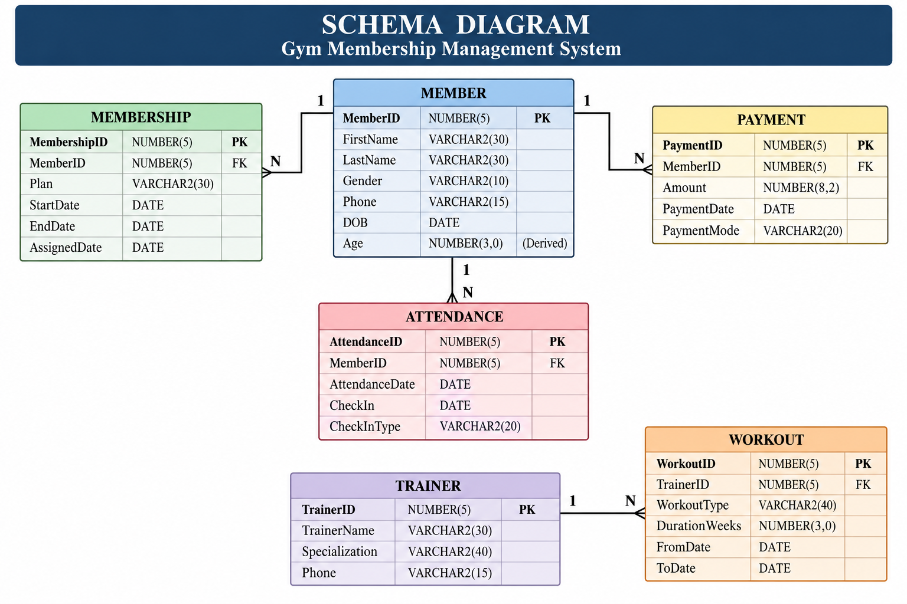
SCHEMA SEPERATION

Slide 14
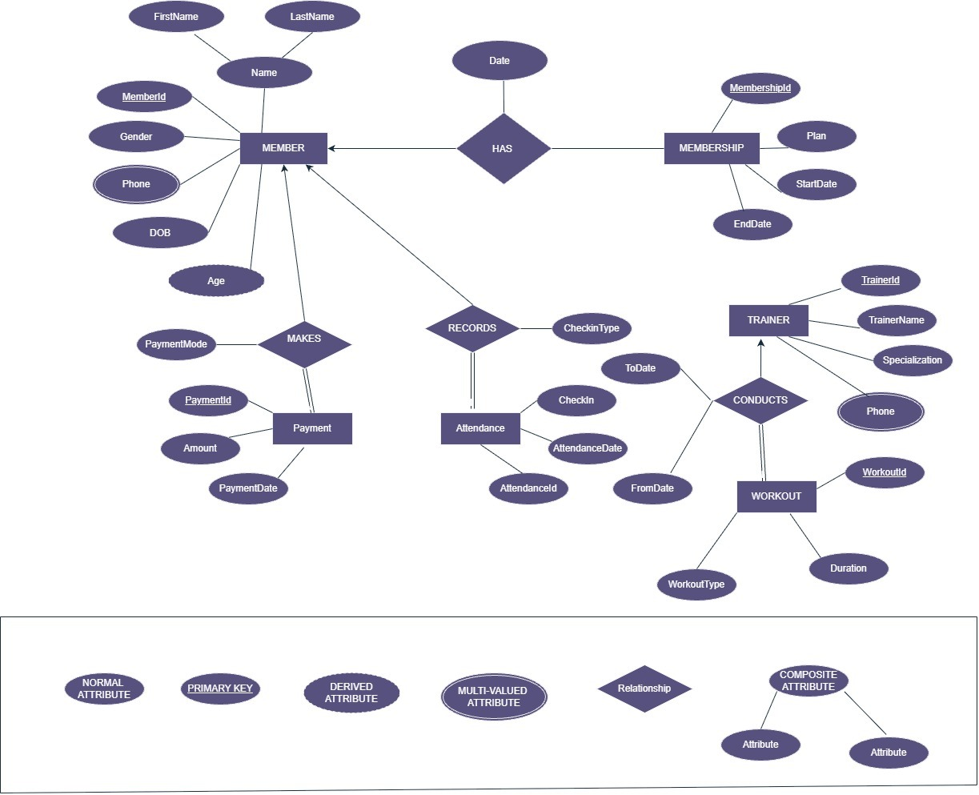
E-R DIAGRAM

Slide 15


E-R DIAGRAM
Entities & Their Attributes
Relationships (1:M Cardinality)
Entity
Attributes
MEMBER
MEMBER
MemberID (PK), FirstName, LastName, Gender, Phone, DOB, Age*
Central entity — links to Membership, Payment, and Attendance
TRAINER
TrainerID (PK), TrainerName, Specialization, Phone
MEMBERSHIP / PAYMENT / ATTENDANCE
MEMBERSHIP
MembershipID (PK), MemberID (FK), Plan, StartDate, EndDate
Each dependent on Member via MemberID (FK)
PAYMENT
PaymentID (PK), MemberID (FK), Amount, PaymentDate
TRAINER
Links to Workout via TrainerID (FK)
ATTENDANCE
AttendanceID (PK), MemberID (FK), AttendanceDate, CheckIn
WORKOUT
WORKOUT
WorkoutID (PK), TrainerID (FK), WorkoutType, Duration
Each workout record belongs to one trainer
* Age is a derived attribute — computed, not stored directly.

Slide 16
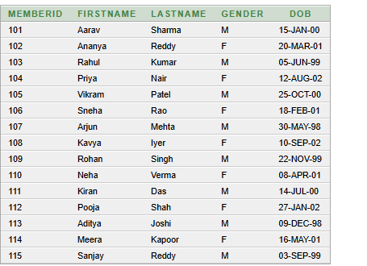
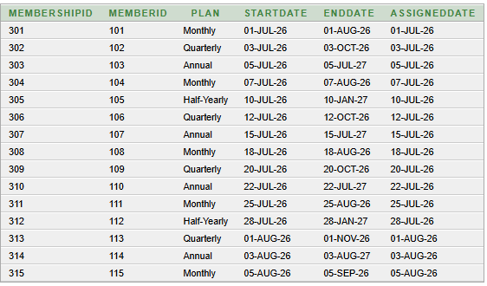
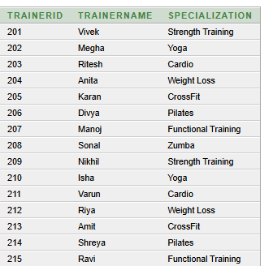
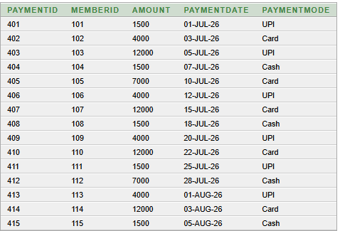
TABLE DATA
MEMBERSHIP:
MEMBER:
TRAINER:
PAYMENT:

Slide 17
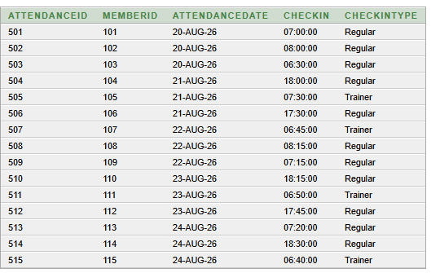
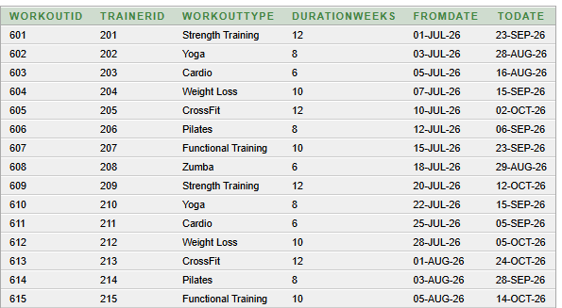
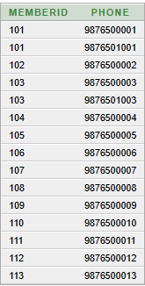
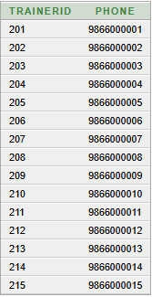
TABLE DATA
ATTENDANCE:
WORKOUT:
MEMBER_PHONE:
TRAINER_PHONE:

Slide 18
NORMALIZATION
1NF — Atomic Data
2NF — Separate Dependencies
3NF — Final Structure
Single value in each field.
No repeating groups.
Member and membership details are atomic.
Member attributes depend on MemberID.
Membership attributes depend on MembershipID.
Redundancy is reduced.
Keep entity attributes with their entity.
Use primary and foreign keys for relationships.
Improves integrity.
Final project database tables
Table | Purpose | Primary Key
MEMBER | Member details | MemberID
MEMBER_PHONE | Member phone | MemberID + Phone
TRAINER | Trainer details | TrainerID
TRAINER_PHONE | Trainer phone | TrainerID + Phone
MEMBERSHIP | Membership details | MembershipID
PAYMENT / ATTENDANCE / WORKOUT | Transactions & training | Own ID

Slide 19
First Normal Form
MEMBER_ID | MEMBERSHIP_ID | FIRSTNAME | LASTNAME | GENDER | PLAN | STARTDATE | ENDDATE
101 | 301 | Aarav | Sharma | M | Monthly | 01-Jul-26 | 01-Aug-26
102 | 302 | Ananya | Reddy | F | Quarterly | 03-Jul-26 | 03-Oct-26
103 | 303 | Rahul | Kumar | M | Annual | 05-Jul-26 | 05-Jul-27
104 | 304 | Priya | Nair | F | Monthly | 07-Jul-26 | 07-Aug-26
105 | 305 | Vikram | Patel | M | Half-Yearly | 10-Jul-26 | 10-Jan-27
FIRST(MEMBER_ID, MEMBERSHIP_ID, FIRSTNAME, LASTNAME, GENDER, DOB,
PLAN, STARTDATE, ENDDATE, ASSIGNEDDATE)
PRIMARY KEY (MEMBER_ID, MEMBERSHIP_ID)
FD: MEMBER_ID → FIRSTNAME, LASTNAME, GENDER, DOB
MEMBERSHIP_ID → PLAN, STARTDATE, ENDDATE, ASSIGNEDDATE
All values are atomic, so the relation satisfies 1NF. However, the composite key creates partial dependencies.
DBMS | Gym Membership Management System 10

Slide 20
Second Normal Form
A relation is in 2NF when it is in 1NF and no non-key attribute depends on only part of a composite key.
MEMBER_ID | FIRSTNAME | LASTNAME | GENDER | DOB
101 | Aarav | Sharma | M | 15-Jan-00
102 | Ananya | Reddy | F | 20-Mar-01
103 | Rahul | Kumar | M | 05-Jun-99
104 | Priya | Nair | F | 12-Aug-02
105 | Vikram | Patel | M | 25-Oct-00
MEMBERSHIP_ID | MEMBER_ID | PLAN | STARTDATE | ENDDATE
301 | 101 | Monthly | 01-Jul-26 | 01-Aug-26
302 | 102 | Quarterly | 03-Jul-26 | 03-Oct-26
303 | 103 | Annual | 05-Jul-26 | 05-Jul-27
304 | 104 | Monthly | 07-Jul-26 | 07-Aug-26
305 | 105 | Half-Yearly | 10-Jul-26 | 10-Jan-27
MEMBER(MEMBER_ID, FIRSTNAME, LASTNAME, GENDER, DOB)
PRIMARY KEY (MEMBER_ID)
MEMBERSHIP(MEMBERSHIP_ID, MEMBER_ID, PLAN, STARTDATE, ENDDATE, ASSIGNEDDATE)
PRIMARY KEY (MEMBERSHIP_ID)
FOREIGN KEY (MEMBER_ID) REFERENCES MEMBER(MEMBER_ID)
Change: member attributes depend on MEMBER_ID, while membership attributes depend on MEMBERSHIP_ID. Partial dependency is removed.
DBMS | Gym Membership Management System 11

Slide 21
Third Normal Form
No non-key attribute depends on another non-key attribute. The final relations therefore remain separate.
MEMBER_ID | FIRSTNAME | LASTNAME | GENDER | DOB
101 | Aarav | Sharma | M | 15-Jan-00
102 | Ananya | Reddy | F | 20-Mar-01
103 | Rahul | Kumar | M | 05-Jun-99
104 | Priya | Nair | F | 12-Aug-02
MEMBERSHIP_ID | MEMBER_ID | PLAN | STARTDATE | ENDDATE
301 | 101 | Monthly | 01-Jul-26 | 01-Aug-26
302 | 102 | Quarterly | 03-Jul-26 | 03-Oct-26
303 | 103 | Annual | 05-Jul-26 | 05-Jul-27
304 | 104 | Monthly | 07-Jul-26 | 07-Aug-26
PAYMENT_ID | MEMBER_ID | AMOUNT | PAYMENTDATE | MODE
401 | 101 | 1500 | 01-Jul-26 | UPI
402 | 102 | 4000 | 03-Jul-26 | Card
403 | 103 | 12000 | 05-Jul-26 | UPI
404 | 104 | 1500 | 07-Jul-26 | Cash
TRAINER_ID | TRAINERNAME | SPECIALIZATION
201 | Vivek | Strength Training
202 | Megha | Yoga
203 | Ritesh | Cardio
204 | Anita | Weight Loss
FD: MEMBER_ID → member details | MEMBERSHIP_ID → membership details
PAYMENT_ID → payment details | TRAINER_ID → trainer details
Result: no transitive dependency remains, so the 2NF relations are already in 3NF. The remaining tables follow the same rule.
DBMS | Gym Membership Management System 12

Slide 22
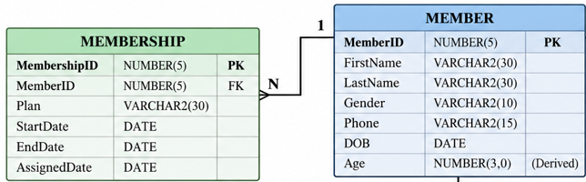
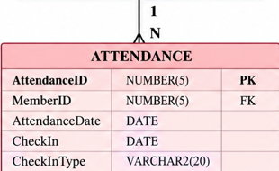
1–4. Member & Trainer → Phone / Membership
1
1. MEMBER 1 — has — N MEMBER_PHONE / MEMBERSHIP
2. TRAINER 1 — has — N TRAINER_PHONE
-- MEMBER TABLE
CREATE TABLE MEMBER (
MemberID NUMBER(5) PRIMARY KEY,
FirstName VARCHAR2(30) NOT NULL,
LastName VARCHAR2(30) NOT NULL,
Gender CHAR(1) CHECK (Gender IN ('M','F')),
DOB DATE NOT NULL
);
-- MEMBER_PHONE
CREATE TABLE MEMBER_PHONE (
MemberID NUMBER(5),
Phone VARCHAR2(15),
PRIMARY KEY (MemberID, Phone),
FOREIGN KEY (MemberID)
REFERENCES MEMBER(MemberID)
);
-- MEMBERSHIP
CREATE TABLE MEMBERSHIP (
MembershipID NUMBER(5) PRIMARY KEY,
MemberID NUMBER(5) NOT NULL,
Plan VARCHAR2(20) NOT NULL,
StartDate DATE NOT NULL,
EndDate DATE NOT NULL,
AssignedDate DATE NOT NULL,
FOREIGN KEY (MemberID)
REFERENCES MEMBER(MemberID)
);
-- TRAINER TABLE
CREATE TABLE TRAINER (
TrainerID NUMBER(5) PRIMARY KEY,
TrainerName VARCHAR2(40) NOT NULL,
Specialization VARCHAR2(40) NOT NULL
);
-- TRAINER_PHONE
CREATE TABLE TRAINER_PHONE (
TrainerID NUMBER(5),
Phone VARCHAR2(15),
PRIMARY KEY (TrainerID, Phone),
FOREIGN KEY (TrainerID)
REFERENCES TRAINER(TrainerID)
);
Relationships: MEMBER → MEMBER_PHONE (1:N) | MEMBER → MEMBERSHIP (1:N) | TRAINER → TRAINER_PHONE (1:N)
GYM MEMBERSHIP MANAGEMENT SYSTEM | Foreign Key Relationships

Slide 23
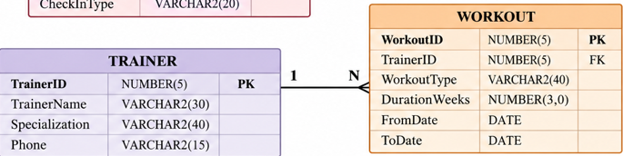
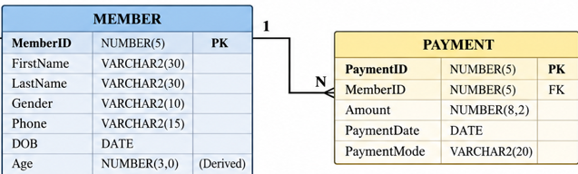
2
5–8. Member → Payment / Attendance & Trainer → Workout
3. MEMBER 1 — makes — N PAYMENT / records — N ATTENDANCE
4. TRAINER 1 — conducts — N WORKOUT
-- PAYMENT TABLE
CREATE TABLE PAYMENT (
PaymentID NUMBER(5) PRIMARY KEY,
MemberID NUMBER(5) NOT NULL,
Amount NUMBER(10,2) CHECK (Amount > 0),
PaymentDate DATE NOT NULL,
PaymentMode VARCHAR2(15),
FOREIGN KEY (MemberID)
REFERENCES MEMBER(MemberID),
CHECK (PaymentMode IN ('Cash','UPI','Card'))
);
-- ATTENDANCE TABLE
CREATE TABLE ATTENDANCE (
AttendanceID NUMBER(5) PRIMARY KEY,
MemberID NUMBER(5) NOT NULL,
AttendanceDate DATE NOT NULL,
CheckIn VARCHAR2(8) NOT NULL,
CheckInType VARCHAR2(15),
FOREIGN KEY (MemberID)
REFERENCES MEMBER(MemberID),
CHECK (CheckInType IN ('Regular','Trainer'))
);
-- WORKOUT TABLE
CREATE TABLE WORKOUT (
WorkoutID NUMBER(5) PRIMARY KEY,
TrainerID NUMBER(5) NOT NULL,
WorkoutType VARCHAR2(40) NOT NULL,
DurationWeeks NUMBER(3)
CHECK (DurationWeeks > 0),
FromDate DATE NOT NULL,
ToDate DATE NOT NULL,
FOREIGN KEY (TrainerID)
REFERENCES TRAINER(TrainerID),
CHECK (ToDate >= FromDate)
);
CARDINALITY SUMMARY • MEMBER → PAYMENT 1:N • MEMBER → ATTENDANCE 1:N • TRAINER → WORKOUT 1:N
CARDINALITY SUMMARY • MEMBER → PAYMENT 1:N • MEMBER → ATTENDANCE 1:N • TRAINER → WORKOUT 1:N
GYM MEMBERSHIP MANAGEMENT SYSTEM | Primary Keys + Foreign Keys + Constraints

Slide 24
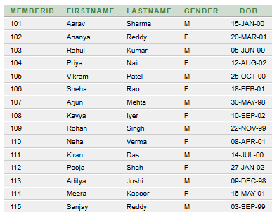
SQL QUERY & OUTPUT
Question 1. Display all members.
SELECT *
FROM MEMBER;
PASTE ORACLE APEX
OUTPUT SCREENSHOT HERE
Replace this box with the screenshot of your result.
Displays all records from the MEMBER table.
DBMS | Gym Membership Management System 2

Slide 25
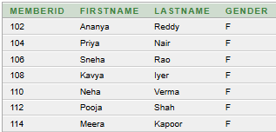
SQL QUERY & OUTPUT
Question 2. Display female members.
SELECT MemberID,
FirstName,
LastName,
Gender
FROM MEMBER
WHERE Gender = 'F';
PASTE ORACLE APEX
OUTPUT SCREENSHOT HERE
Replace this box with the screenshot of your result.
Uses WHERE to filter only female members.
DBMS | Gym Membership Management System 3

Slide 26
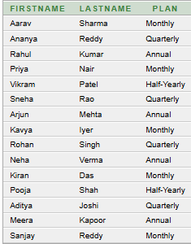
SQL QUERY & OUTPUT
Question 3. Display member names with their membership plans.
SELECT M.FirstName,
M.LastName,
MS.Plan
FROM MEMBER M
JOIN MEMBERSHIP MS
ON M.MemberID = MS.MemberID;
JOIN combines MEMBER and MEMBERSHIP using MemberID.
DBMS | Gym Membership Management System 4

Slide 27
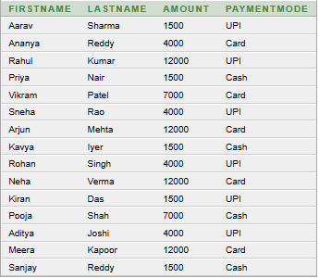
SQL QUERY & OUTPUT
Question 4. Display members with their payment details.
SELECT M.FirstName,
M.LastName,
P.Amount,
P.PaymentMode
FROM MEMBER M
JOIN PAYMENT P
ON M.MemberID = P.MemberID;
Shows the payment made by each member.
DBMS | Gym Membership Management System 5

Slide 28

SQL QUERY & OUTPUT
Question 5. Find the total payment amount.
SELECT SUM(Amount) AS Total_Payment
FROM PAYMENT;
SUM() calculates the total of all payment amounts.
DBMS | Gym Membership Management System 6

Slide 29
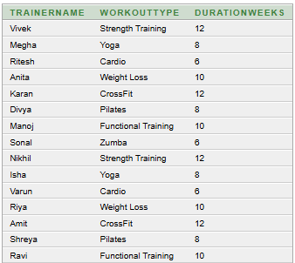
SQL QUERY & OUTPUT
Question 6. Display trainer and workout details.
SELECT T.TrainerName,
W.WorkoutType,
W.DurationWeeks
FROM TRAINER T
JOIN WORKOUT W
ON T.TrainerID = W.TrainerID;
JOIN connects each workout to its trainer.
DBMS | Gym Membership Management System 7

Slide 30
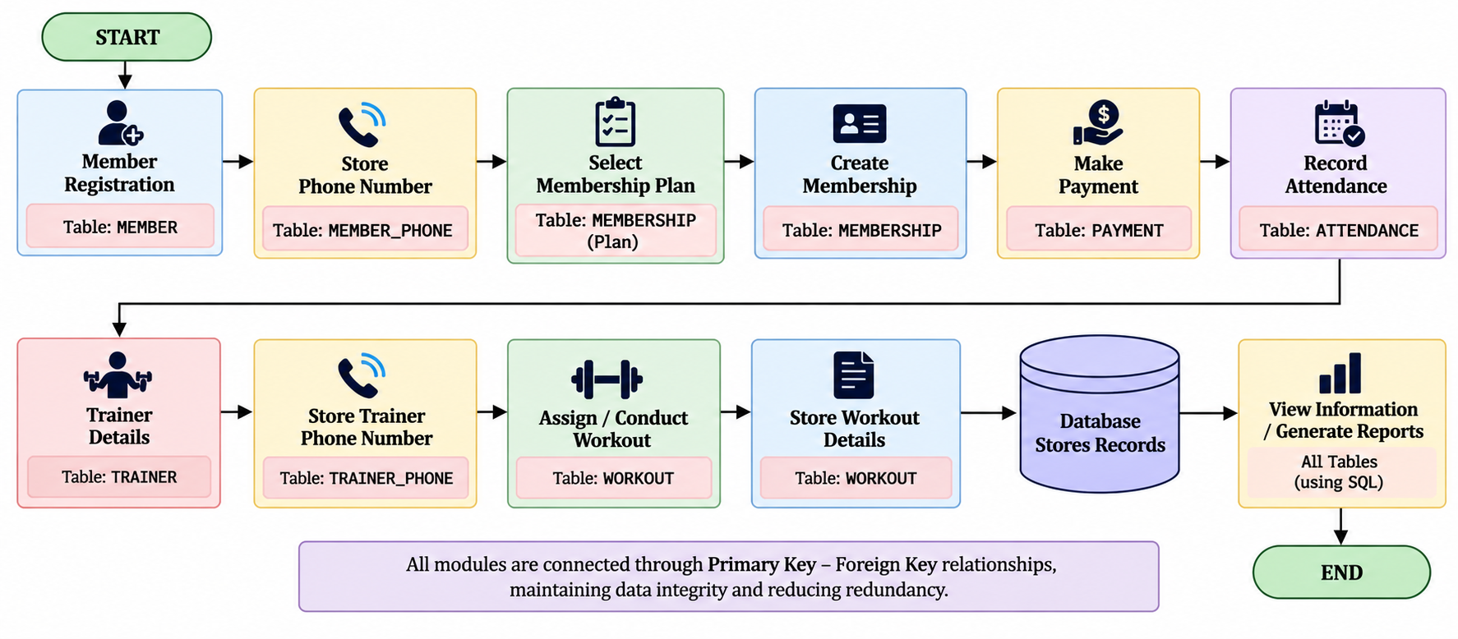
FLOWCHART
2

Slide 31
CONCLUSION
6 Entities Designed
4 Relationships
Member, Trainer, Membership, Payment, Attendance, Workout — each fully attributed with primary and foreign keys.
All relationships are 1:M cardinality, enforced through foreign key constraints across dependent tables.
3NF Normalized
Complete SQL Coverage
The schema eliminates redundancy, partial dependencies, and transitive dependencies through full normalization.
DDL (CREATE), DML (INSERT, UPDATE, DELETE), and JOIN queries demonstrated for all core operations.
The Gym Membership Management System provides a centralized and structured way to manage gym records.
It manages Member, Trainer, Membership, Payment, Attendance, and Workout information.
The system reduces the problems associated with manual and scattered record keeping.
Primary keys and foreign keys help maintain data integrity and relationships between entities.
The 1:M relationships effectively represent the major interactions in the system.
The relational database design helps reduce redundancy and improve consistency.
The system enables faster and more accurate retrieval of gym information.
The project provides a strong foundation for future expansion of gym management features.
Overall, the proposed system provides an organized, reliable, and efficient database solution for managing essential gym operations.

Slide 32
Thank You
GYM MEMBERSHIP MANAGEMENT SYSTEM
DBMS Cornerstone Project

